Slide 1
KLE SPORTS MANAGEMENT
BY
VARUN HEGDE
PRAVEEN SHETTY

Slide 2
INTRODUCTION
The web application, which facilitates the sports department to maintain the materials and stocks of the sports department. Managing the sports activities and maintaining the records of the department.

Slide 3
Objective of the project
The objective is to develop a web application for the sports department. To maintain the sports activities efficiently

Slide 4
EXISTING SYSTEM
All the sports activities are maintained manually. The PD head has to send the circular to all departments to notify about the sports events.

Slide 5
Proposed system
The web application, which facilitates the sports department to maintain the materials and stocks of the sports department.
Managing the sports activities and maintaining the records of the department.
With this system the physical department head can post the events like inter college and zonal events.
The events posted by the department is available to students on the website

Slide 6
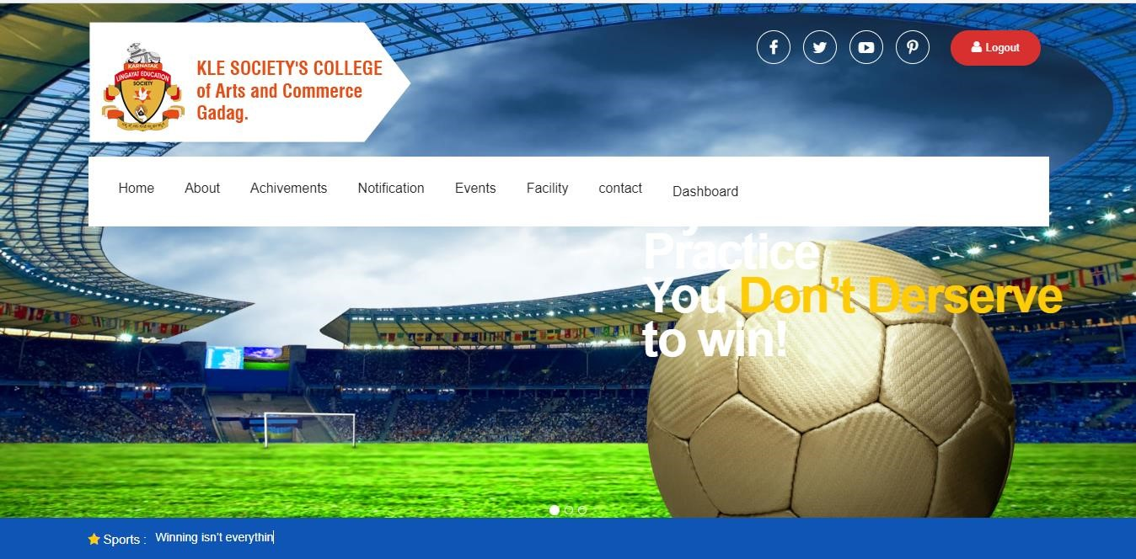
Home page

Slide 7
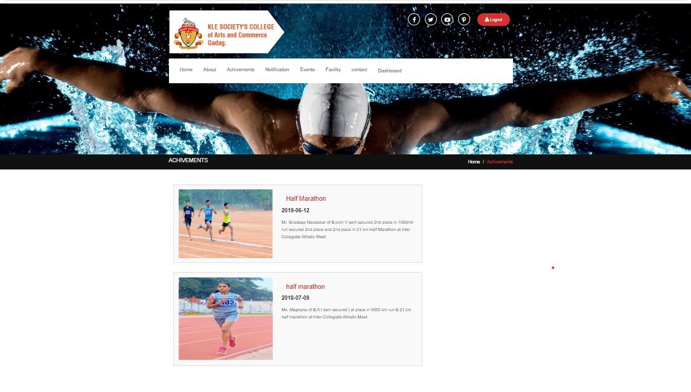
Achievement page

Slide 8
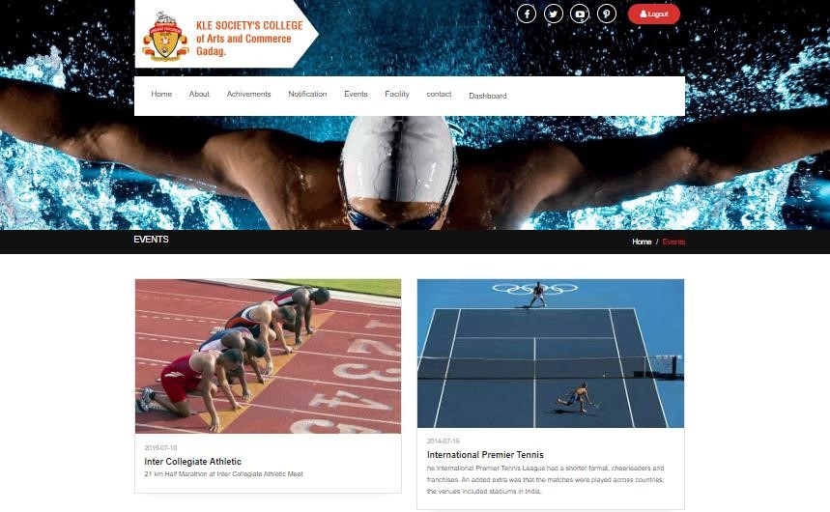
EVENT PAGE

Slide 9
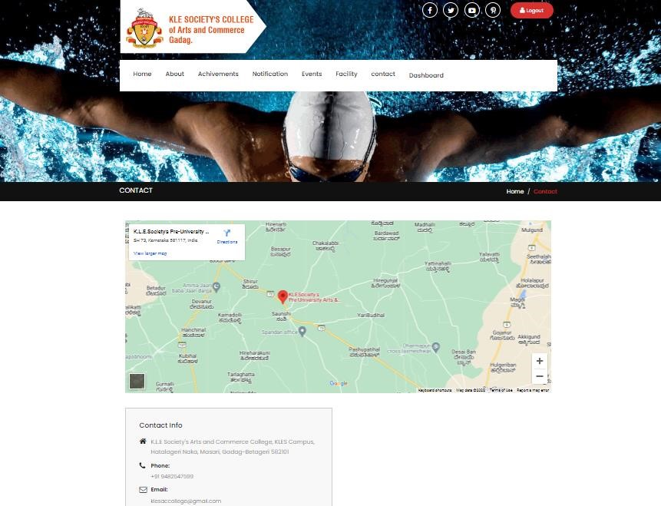
CONTACT PAGE

Slide 10
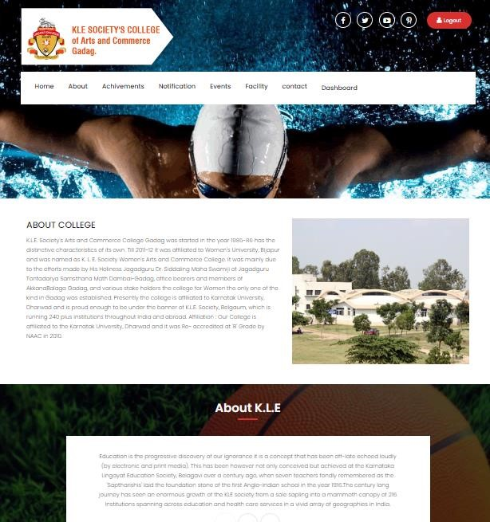
ABOUT PAGE

Slide 11
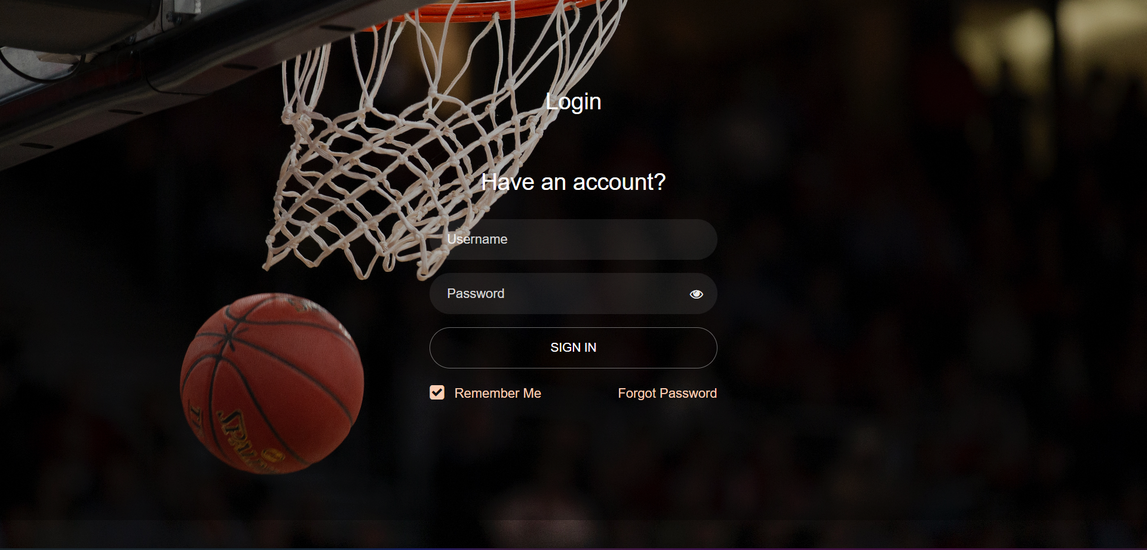
Login page

Slide 12
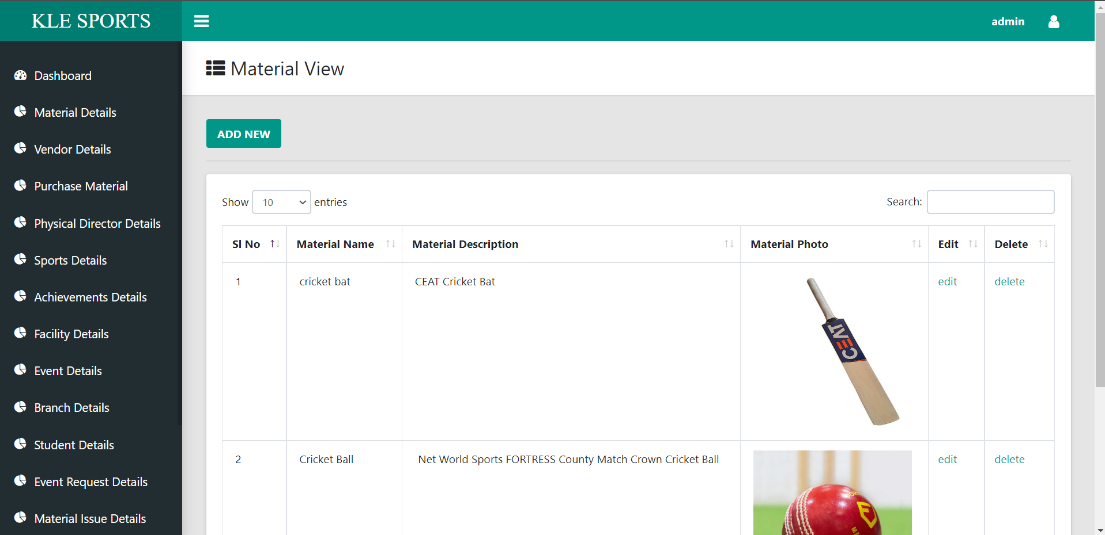
Admin page

Slide 13
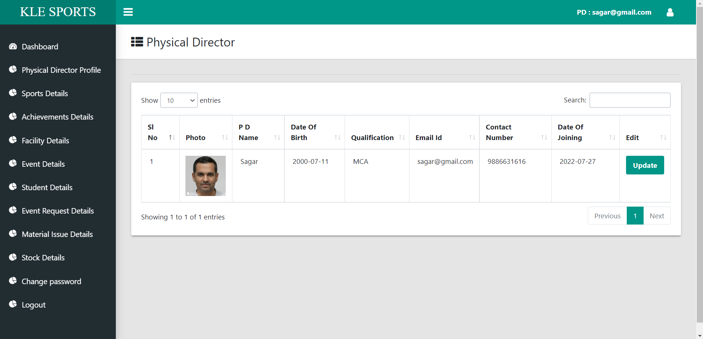
PD page

Slide 14
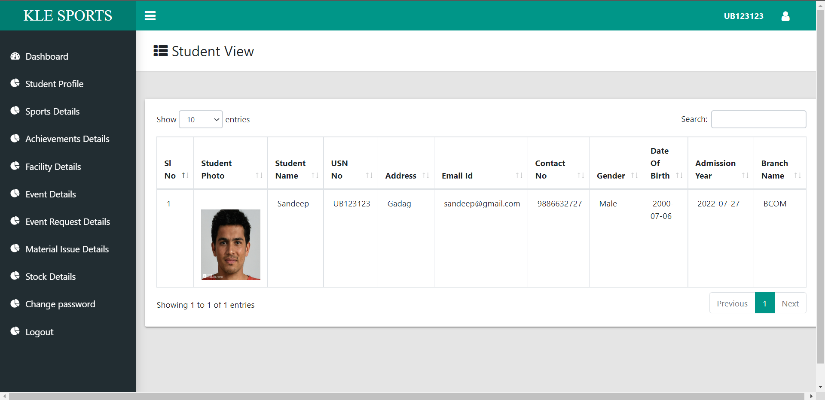
User page

Slide 15
Input
Admin Login
Student Registration
Sports Event
Games

Slide 16
output
Sports management system is not only rewarding but it also helps to quickly organize the sports events interval of the time.
It will be able to check anything related to sports at any time.
Paper work and manual work is reduced through this system.
The system is user friendly and easy to use.

Slide 17
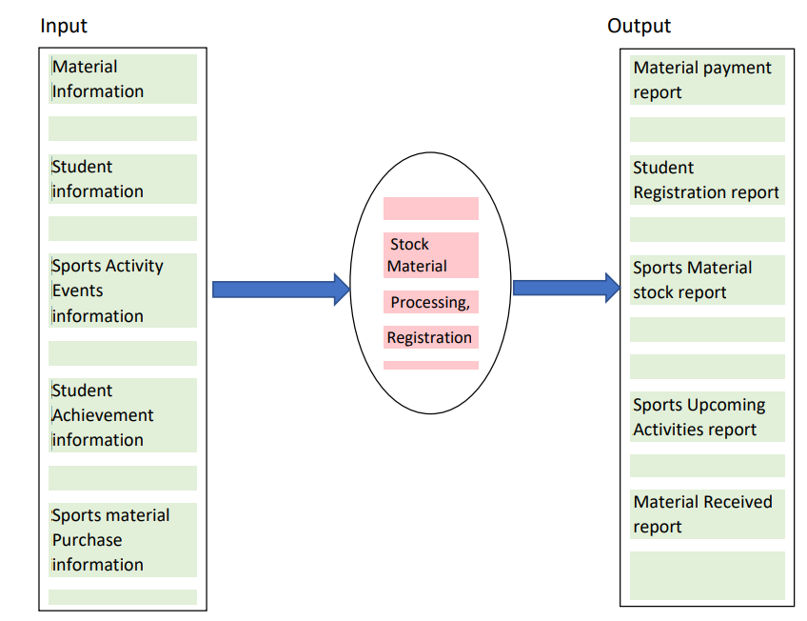
Process logic

Slide 18
Modules
Admin
Student
Pd details(physical director)

Slide 19
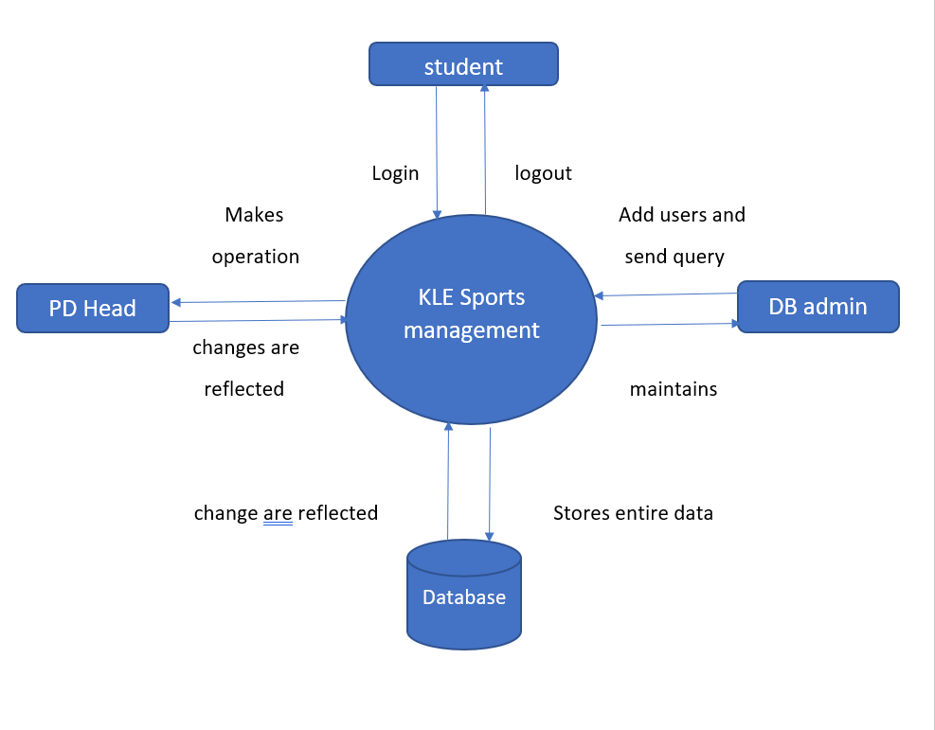
Zero level DFD

Slide 20
Minimum hardware requirement
PROCESSOR:PENTIUM IV OR ABOVE
RAM:512 MB OR MORE
HARD DISC:20GB OF AVAILABLE SPACE OF HARD DISC

Slide 21
Software specification
FRONT END:HTML,CSS
OPERATING SYSTEM:WINDOWS XP,WINDOWS 2000 and above
SERVER SIDE SOFTWARE:XAMPP server
MIDLEWARE : PHP
DATABASE : MySql
DESINING TOOL : Dreamweaver

Slide 22
LIMITATION OF THE PROJECT
Time consuming.
To keep database up to date regular update is needed

Slide 23
FUTURE/SCOPE OF THE PROJECT
Major operations that are done manually can be done within a matter of seconds.
Live video stream and live score can be made

Slide 24
THANK YOU

